Slide 1
Staff Development Cell Welcomes You

Slide 2
Expectations

Slide 3
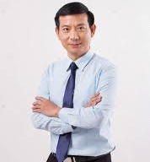
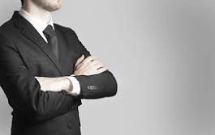
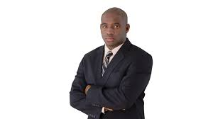
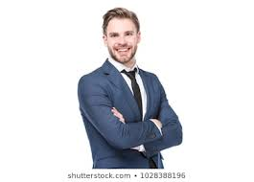
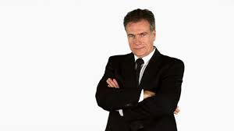
Cross your Arms

Slide 4
Natural Mental Habits
Personality Preference

Slide 6
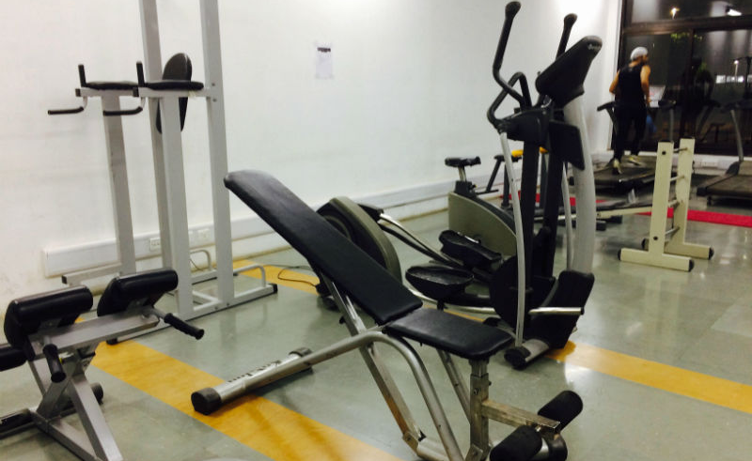
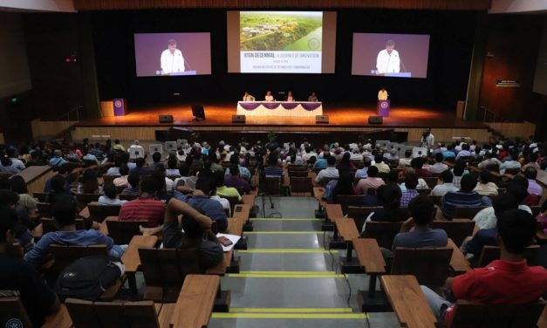

Slide 9
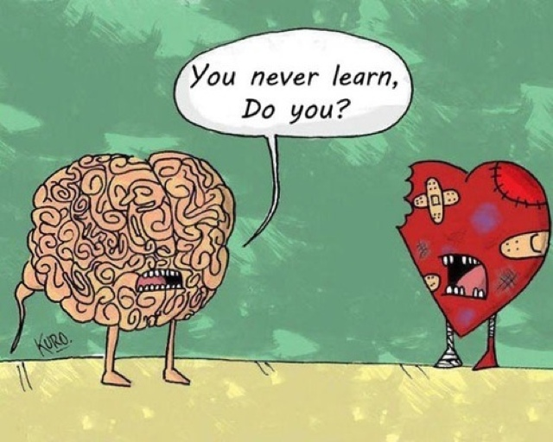

Slide 10
Logic
Values

Slide 11
9:00 – Meeting Starts
9:01 – Problem Identification
9:10 – Discussion on Budget Planning
9:20 – Presentation on Difficulties faced
9:00 – Meeting Starts
चलिए देखते हैं क्या होता है

Slide 13
Why to Decode the Personality Types ?

Slide 14
Know yourself better Better understand others Work in teams Career development

Slide 15
MBTI: Based on Carl Jung’s theory Swiss psychoanalyst Katherine Briggs and Isabelle Briggs Myers, a mother and daughter, integrated his work with their research and developed this very sophisticated and useful tool, Now the most widely used personality indicator in the world. In World War II, MBTI was used to help career placement of women while men were off fighting the war.

Slide 16
Extraverts
= E
Introverts
= I
Sensors
= S
iNtuitives
= N
Thinkers
= T
Feelers
= F
Judgers
= J
Perceivers
= P

Slide 19
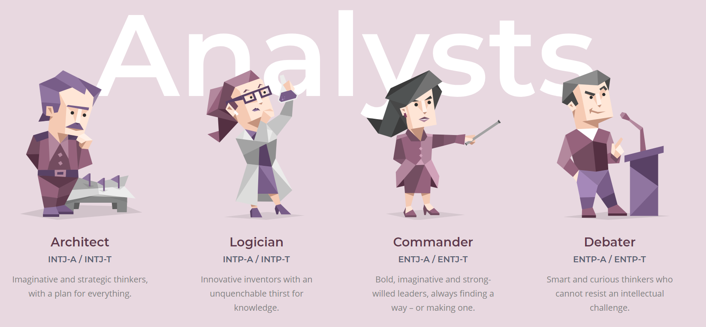

Slide 20
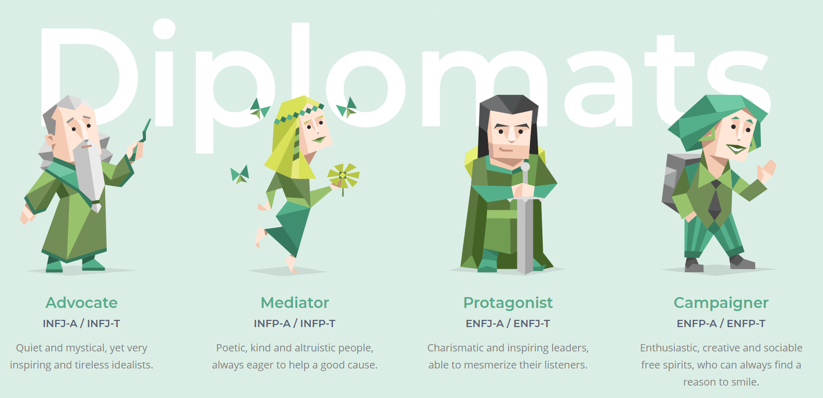

Slide 21
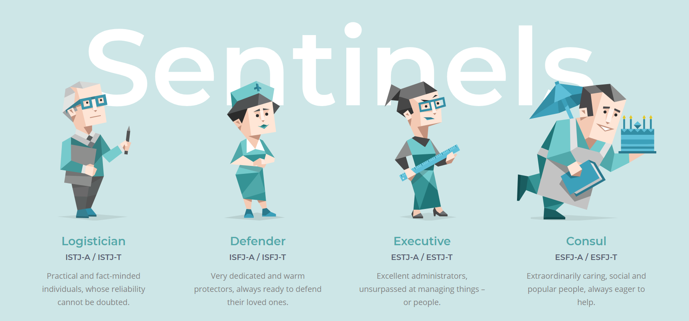

Slide 22
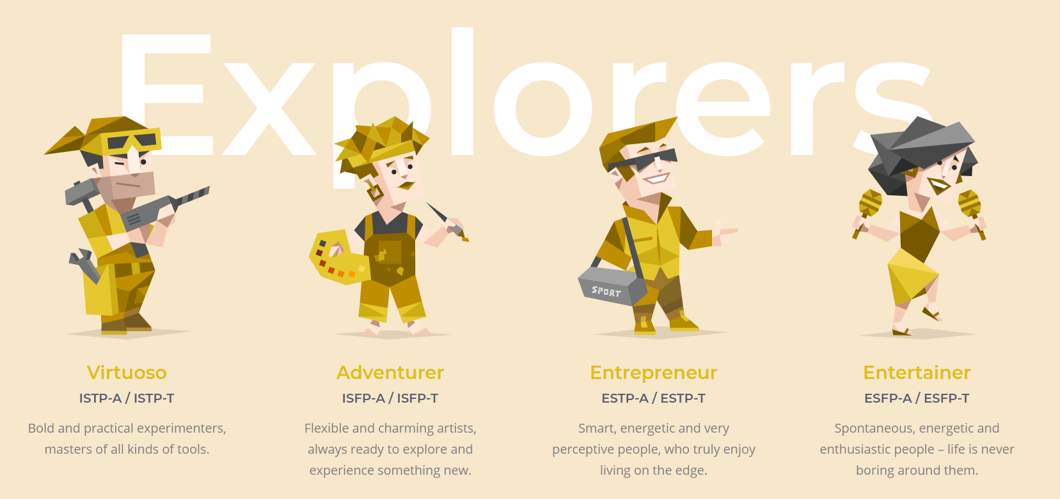

Slide 23
Write down what you feel you are…

Slide 24
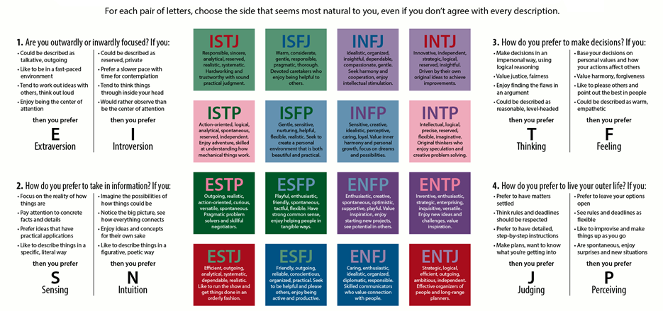

Slide 26
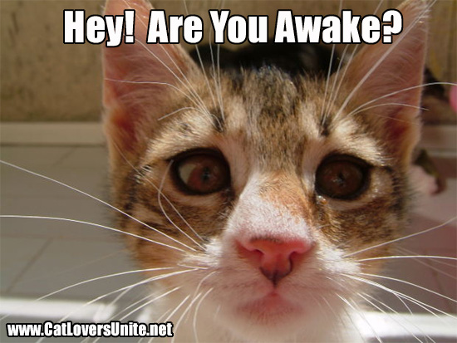
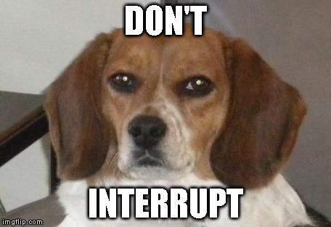

Slide 32
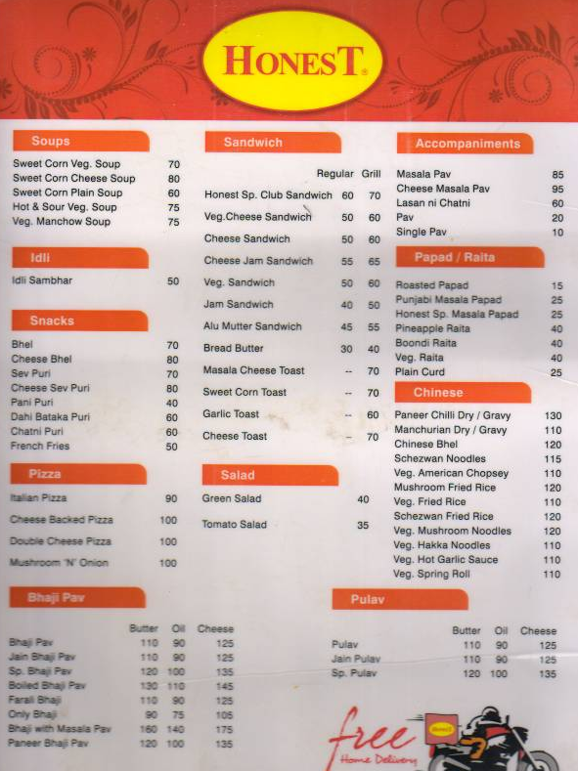

Slide 33
Let’s Decode your Personality Type

Slide 34
Know WHO you are ?
https://www.16personalities.com/free-personality-test

Slide 35
Let’s Validate your Personality Type

Slide 36
Let’s Re-Validate your Personality Type
For the accurate result

Slide 37
Question 1 – How do you get your energy?
are generally sociable | are generally quiet
are focused on the outer world | are focused on their inner world
get energy by spending time with others | get energy by spending time alone
talk a lot & start conversations | mostly listen & wait for others to talk first
speak first, then think | think first, then speak
are quick to take action | are slow to take action
have many friends & many interests | have a few deep friendships & refined interests
Question 2 – How do you see the world & gather information?
have finely-tuned five senses | use their “sixth sense”
pay attention to the details | see the “big picture”
focus on what is real (in the present) | focus on what is possible (in the future)
think in concrete terms | think in abstract terms
like practical things | like theories
like to do (make) | like to dream (design)
are accurate and observant | are creative and imaginative
prefer to do things the established way | prefer to try out new ideas
Question 3 – How do you make your decisions?
mostly use their head | mostly use their heart
make decisions based on logic | make decisions based on their values
are more interested in things & ideas | are more interested in people & emotions
treat everybody the same (emphasizing fairness) | treat people according to their situation (emphasizing compassion)
are more scientific in describing the world | are more poetic in describing the world
Question 4 – How much do you like to plan ahead?
are organized and structured | are casual and relaxed
make plans in advance | prefer to “go with the flow”
keep to the plan | are able to change and adapt quickly
like to be in control of their life | like to simply let life happen
want to finalize decisions | want to find more information

Slide 38
Question 1 – How do you get your energy?
Extraverts = E | Introverts = I
are generally sociable | are generally quiet
are focused on the outer world | are focused on their inner world
get energy by spending time with others | get energy by spending time alone
talk a lot & start conversations | mostly listen & wait for others to talk first
speak first, then think | think first, then speak
are quick to take action | are slow to take action
have many friends & many interests | have a few deep friendships & refined interests
Question 2 – How do you see the world & gather information?
Sensors = S | intuitives = N
have finely-tuned five senses | use their “sixth sense”
pay attention to the details | see the “big picture”
focus on what is real (in the present) | focus on what is possible (in the future)
think in concrete terms | think in abstract terms
like practical things | like theories
like to do (make) | like to dream (design)
are accurate and observant | are creative and imaginative
prefer to do things the established way | prefer to try out new ideas
Question 3 – How do you make your decisions?
Thinkers = T | Feelers = F
mostly use their head | mostly use their heart
make decisions based on logic | make decisions based on their values
are more interested in things & ideas | are more interested in people & emotions
treat everybody the same (emphasizing fairness) | treat people according to their situation (emphasizing compassion)
are more scientific in describing the world | are more poetic in describing the world
Question 4 – How much do you like to plan ahead?
Judgers = J | Perceivers = P
are organized and structured | are casual and relaxed
make plans in advance | prefer to “go with the flow”
keep to the plan | are able to change and adapt quickly
like to be in control of their life | like to simply let life happen
want to finalize decisions | want to find more information

Slide 42
Convert Hobby into Passion
And Passion into Profession

Slide 43
Hunt for the right nest
कर्म पूजा है!

Slide 44
https://tinyurl.com/y38hh9xj https://tinyurl.com/zqnugq2
Visit above links If you want to know more about your personality type

Slide 45
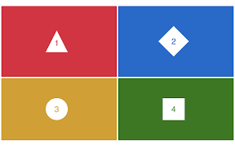
Quiz Time

